Slide 1
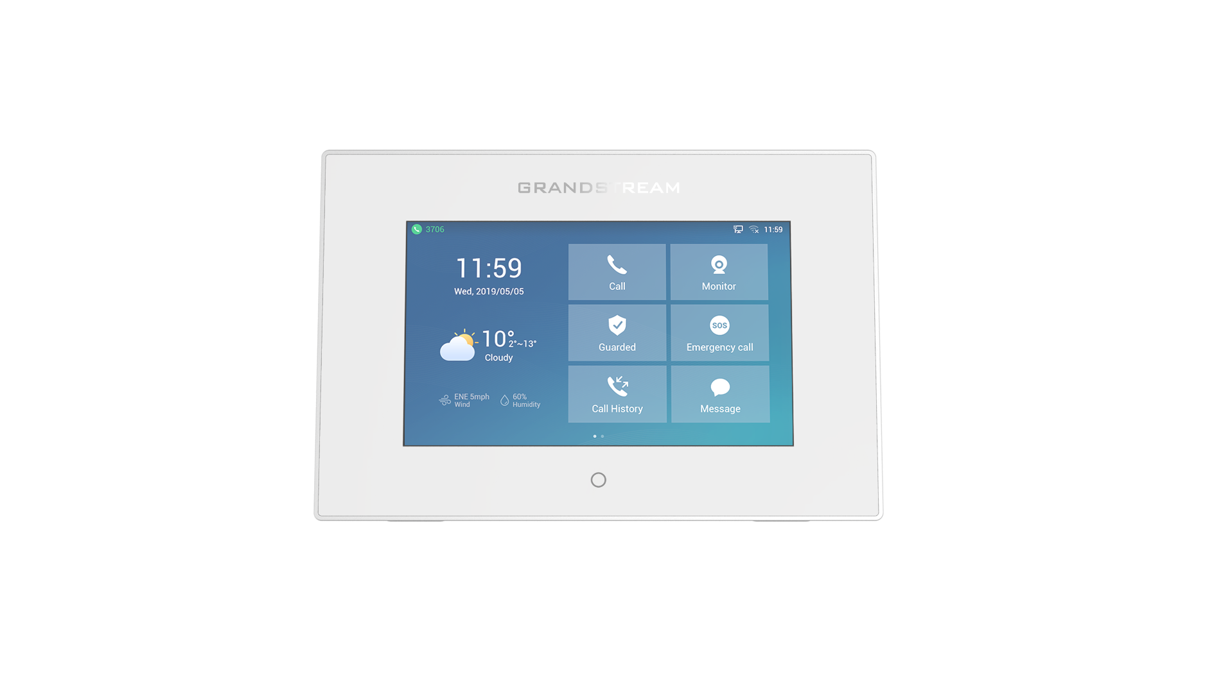
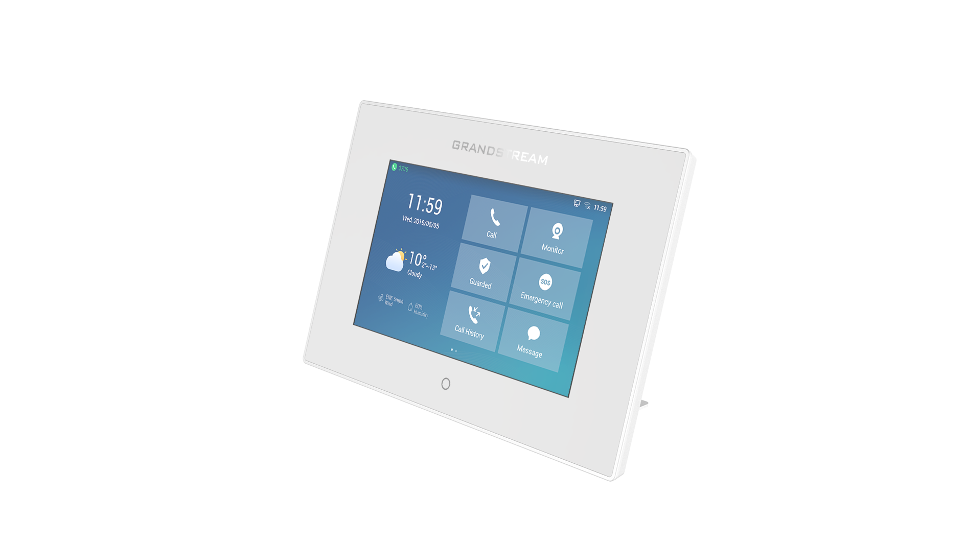
GSC3570
HD Intercom and Facility Control Station
A powerful control station, the GSC3570 provides users with a wall-mounted or desktop solution for door control, intercom and paging, security camera management, and facility-wide UC integration. This SIP intercom device is designed to seamlessly integrate with Grandstream’s entire range of products, including our SIP door systems, security cameras, and intercom and paging devices.
Competitive Features
Full-duplex 2-way HD audio with advanced echo cancellation
Dual-band 802.11ac Wi-Fi
4x alarm input ports
1x alarm output port
7-inch 1024x600 capacitive touch screen
4 SIP accounts
 | GSC3570 | 2N Indoor Touch 2.0 | Hikvision DS-KH8300-T
Network Interfaces | Dual switched 10/100Mbps ports with integrated PoE | 10/100 BaseT, RJ-45 | 10/100 Mbps self-adaptive Ethernet
Graphic Display | 7’’ 1024×600 capacitive touch screen TFT LCD with Home Key | 7” 1024x600 capacitive touch screen | 7” 1024x600 capacitive color TFT touch screen LCD, touch button
Auxiliary Ports | 4 x Alarm Input 1 x Alarm Output Micro SD card slot | 2 x Relay 2 x GPIO (doorbell input, etc.) Micro SD card slot (up to 16GB) | 1 x RJ-45 10/100 Mbps ethernet 1 x RS-485 half-duplex port 2 x in/out Micro SD card slot (up to 32GB)
Operating System | Linux 4.4 | Android 6.0 | Linux
Wi-Fi | Yes, dual-band 802.11b/g/n/ac (2.4GHz & 5GHz) | Optional (802.11b/g/n) | No
Audio | HD Audio, dual speakers | HD Audio, 2W integrated speaker | Omnidirectional mic, loudspeaker
Telephony Features | 4 SIP accounts, hold, call waiting, call log, auto answer, etc. | Video messaging answering machine, 3rd party applications | Panic call, auto-answering, Do Not Disturb
Temperature and Humidity | Operation: -10°C to 50°C, Storage: -20°C to 60°C, Humidity: 10% to 90% Non-condensing | Operation: 0°C – 60°C, Storage: -20 °C – 70 °C, Humidity: 10% – 90% (non-condensing) | Operation: -10° C to 55° C, Humidity: 10 to 90%
Voice/Video Codecs | G.711μ/a, G.722 (wide-band), G.726-32, iLBC, Opus, G.729A/B, in-band and out-of-band, DTMF (In audio, RFC2833, SIP INFO), VAD, CNG, AEC, PLC, AJB, AGC, ANS | H.264, MJPEG | G.711 U
Full-duplex speakerphone
Integrated dual-band Wi-Fi
4 x alarm inputs
1 x alarm outputs
Integrated Bluetooth 4.0

